Slide 1
Competitive Programming
Andrei Novikov
15 March 2024

Slide 2
DYNAMIC PROGRAMMING

Slide 3

DP – Longest Increasing Sequence
Refresh O(N²) approach, but with extension to restore the sequence.
Source: Kattis
Task: Increasing Subsequence
Task ID: increasingsubsequence

Slide 4
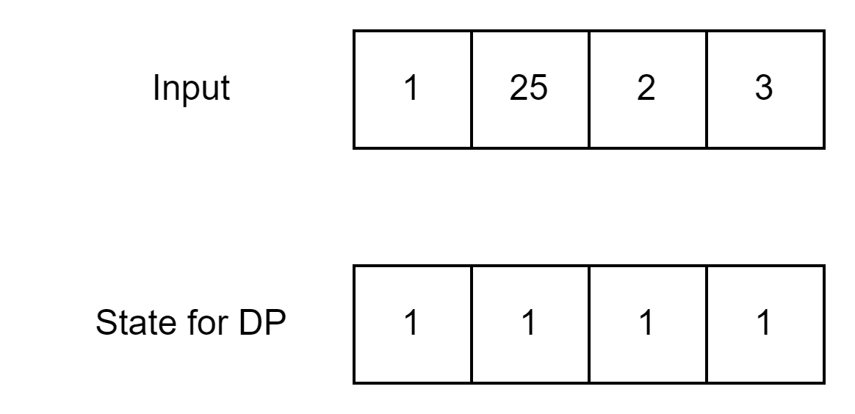
Longest Subsequence Approach

Slide 5
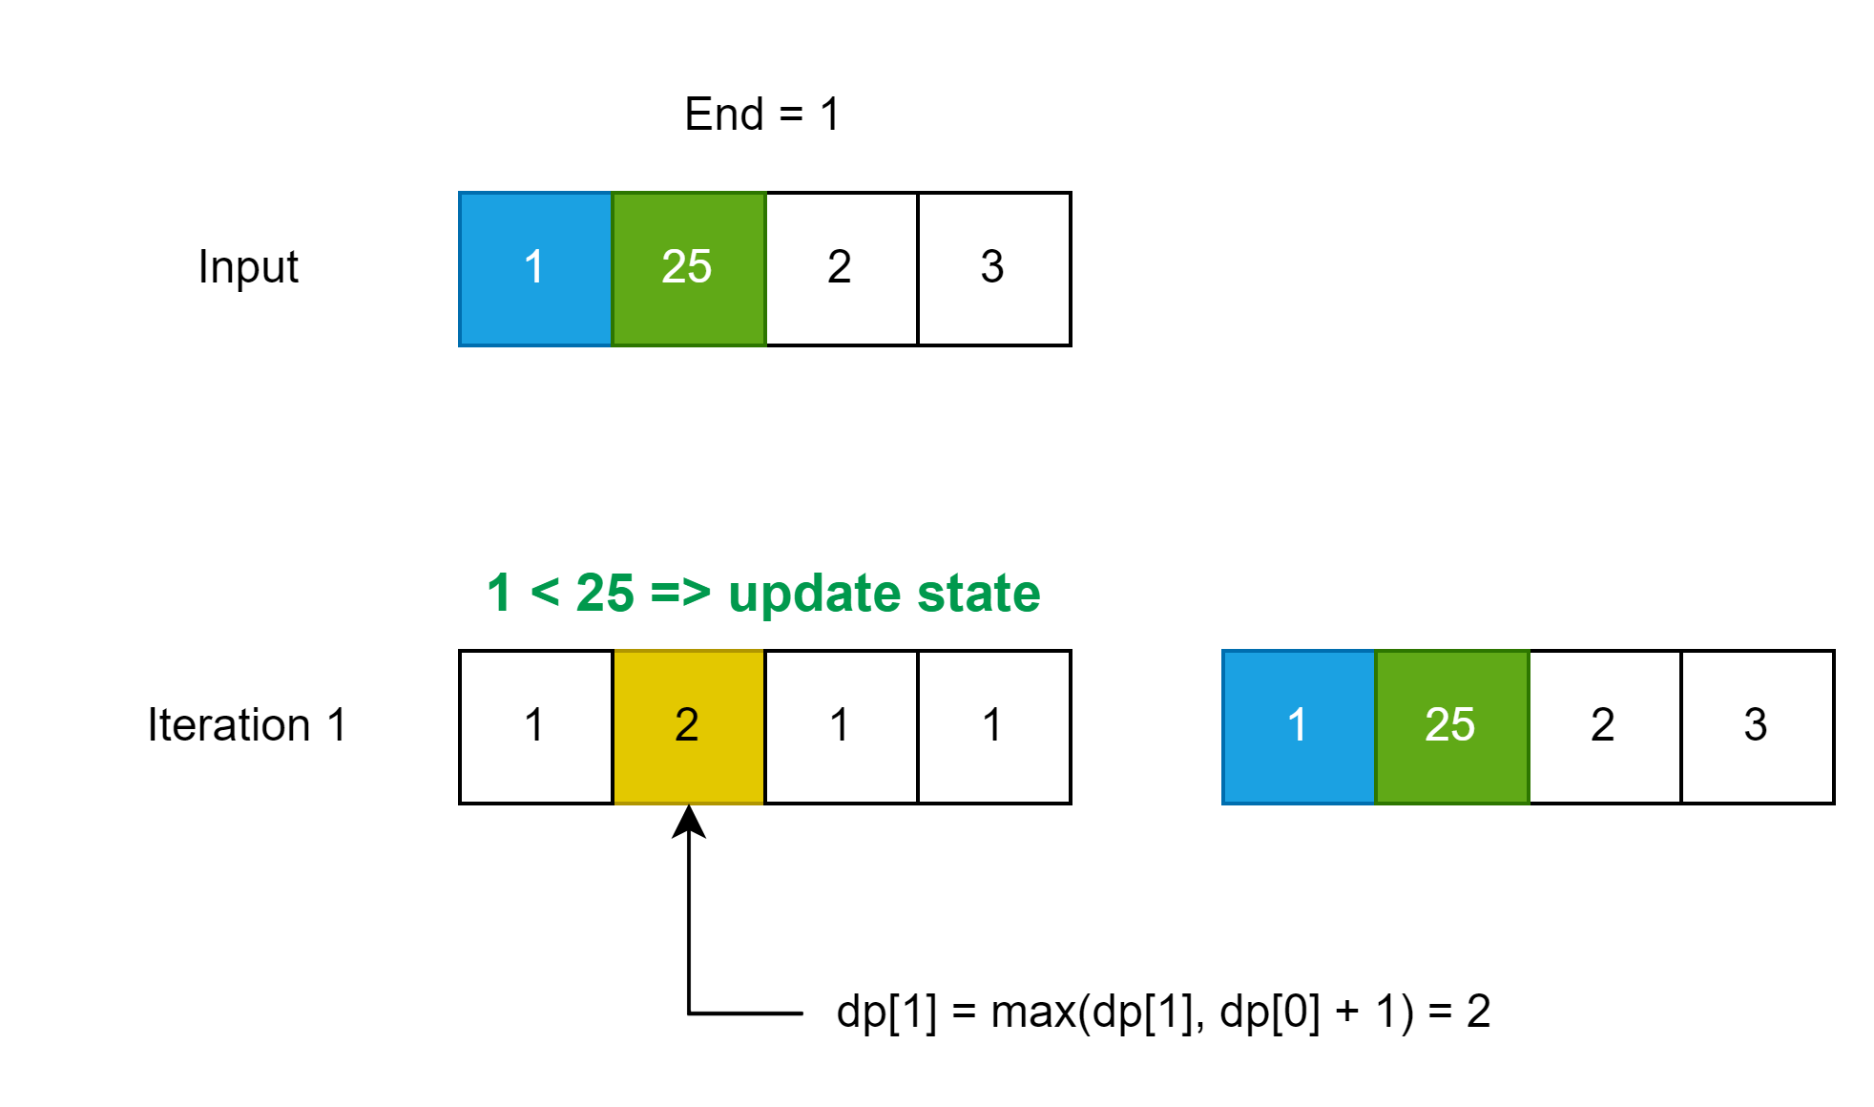
Longest Subsequence Approach

Slide 6
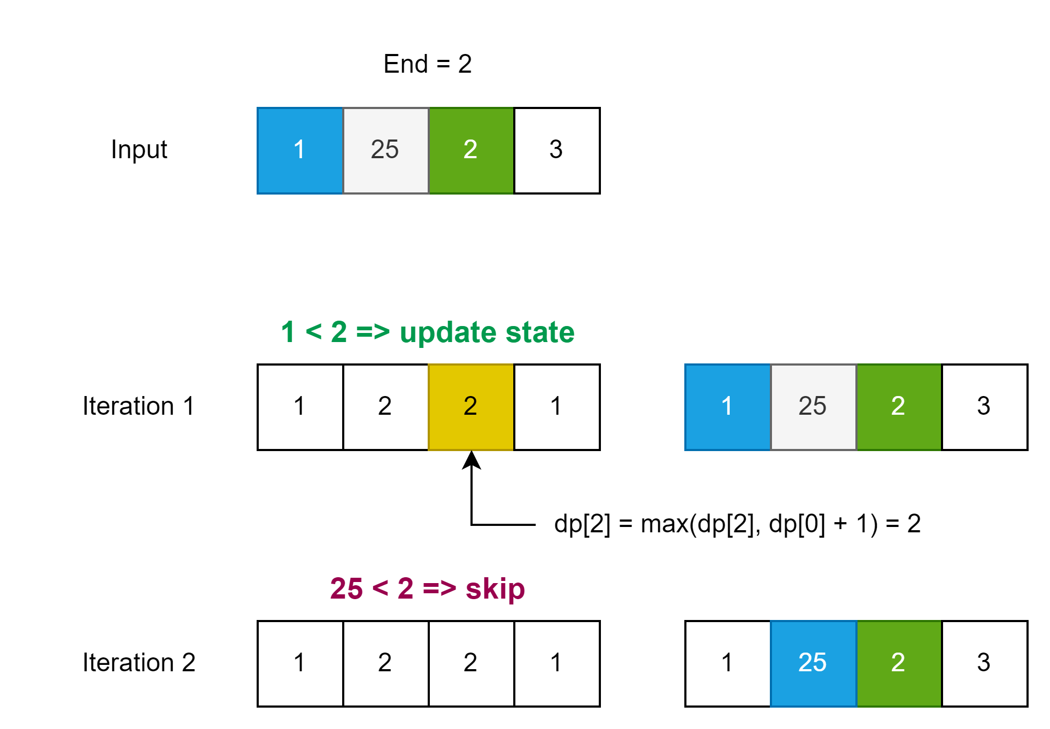
Longest Subsequence Approach

Slide 7
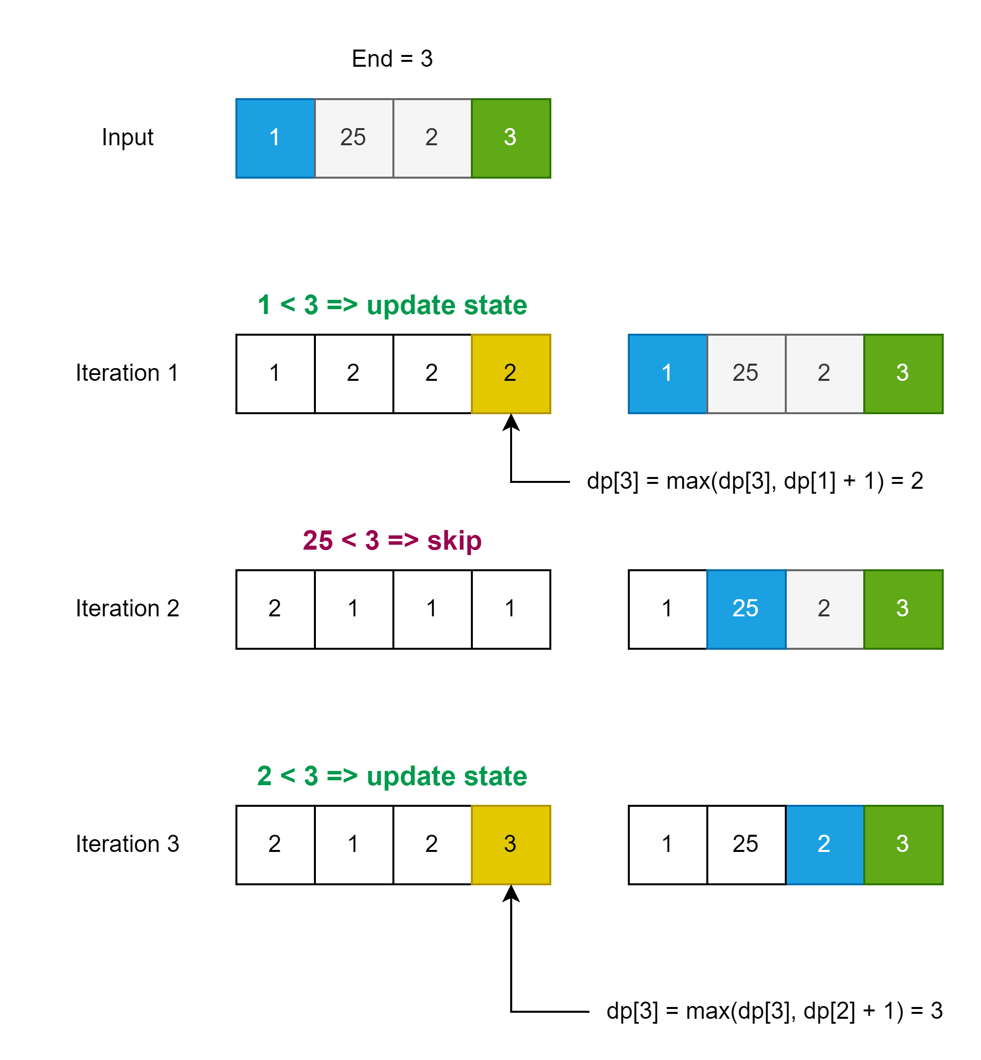
Longest Subsequence Approach

Slide 8
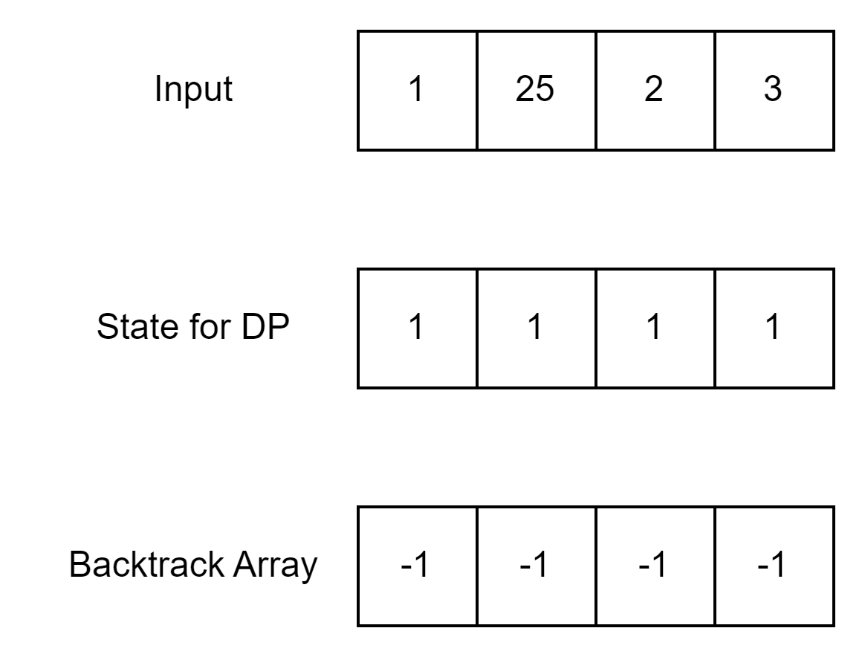
How to Restore the Sequence?
Use an array where we point to the previous element.

Slide 9
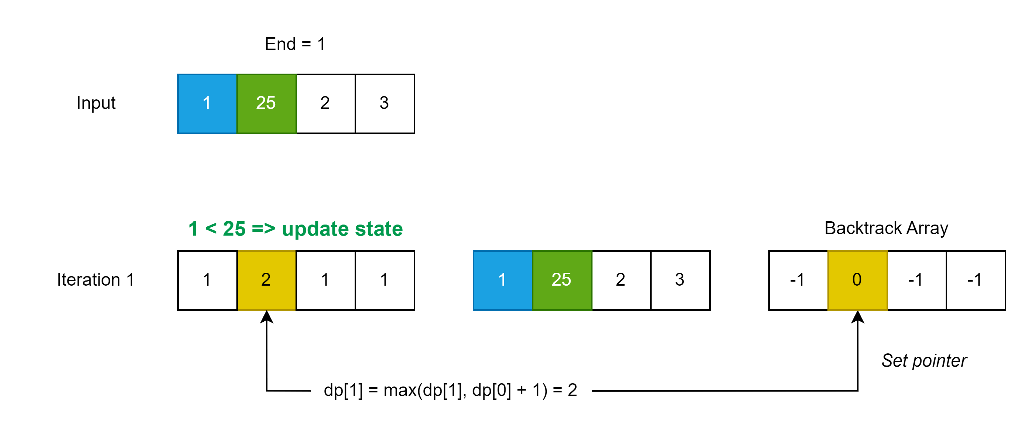
How to Restore the Sequence?
Use an array where we point to the previous element.

Slide 10
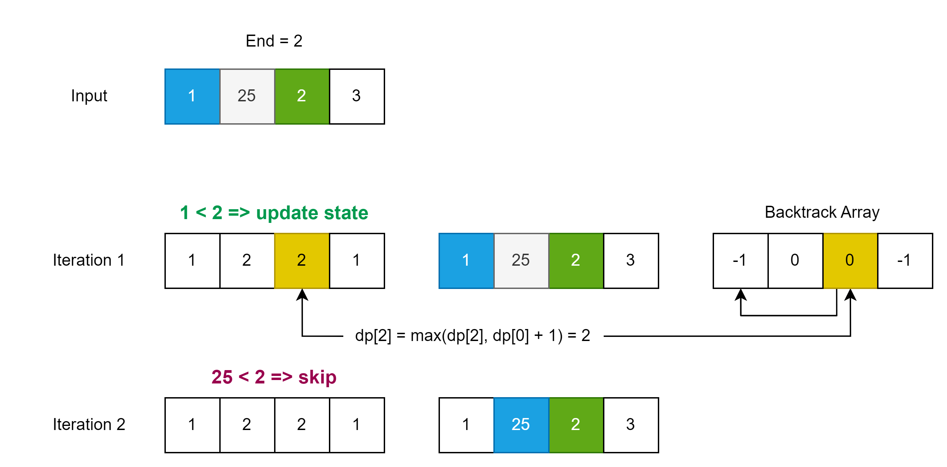
How to Restore the Sequence?
Use an array where we point to the previous element.

Slide 11
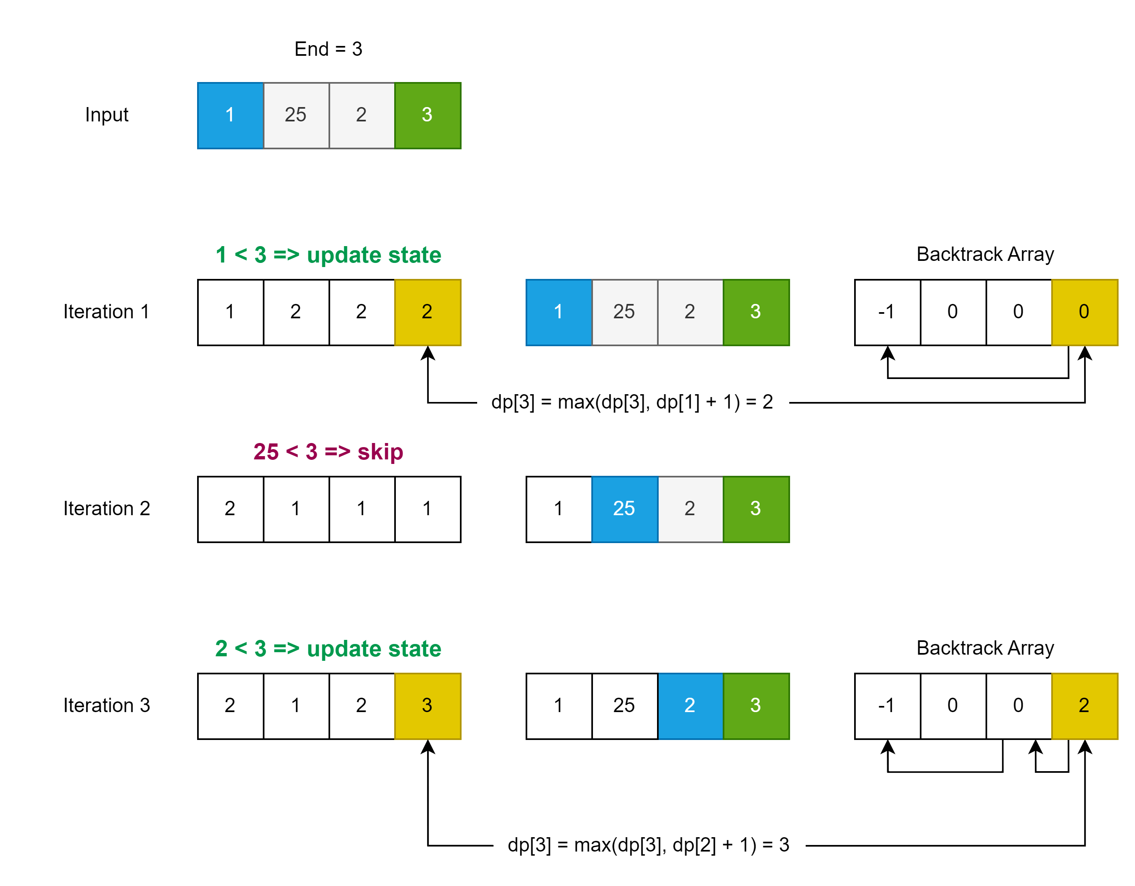
How to Restore the Sequence?

Slide 12
What about lexicographically minimum?
This time no schemes, just update previous point when
dp[i] == dp[j] + 1 ← Current length is equal to previous + 1;
Implement the solution and submit:
Source: Kattis
Task: Increasing Subsequence
Task ID: increasingsubsequence

Slide 13
GRAPHS

Slide 14
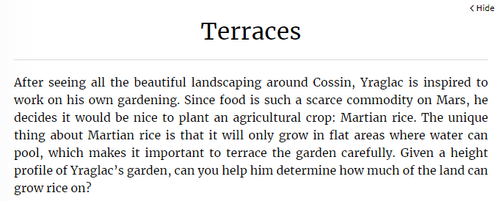
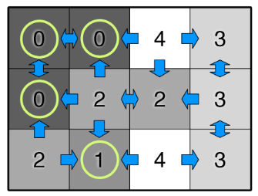
Graphs – Find Connected Component
Source: Kattis
Task: Terraces
Task ID: terraces

Slide 15
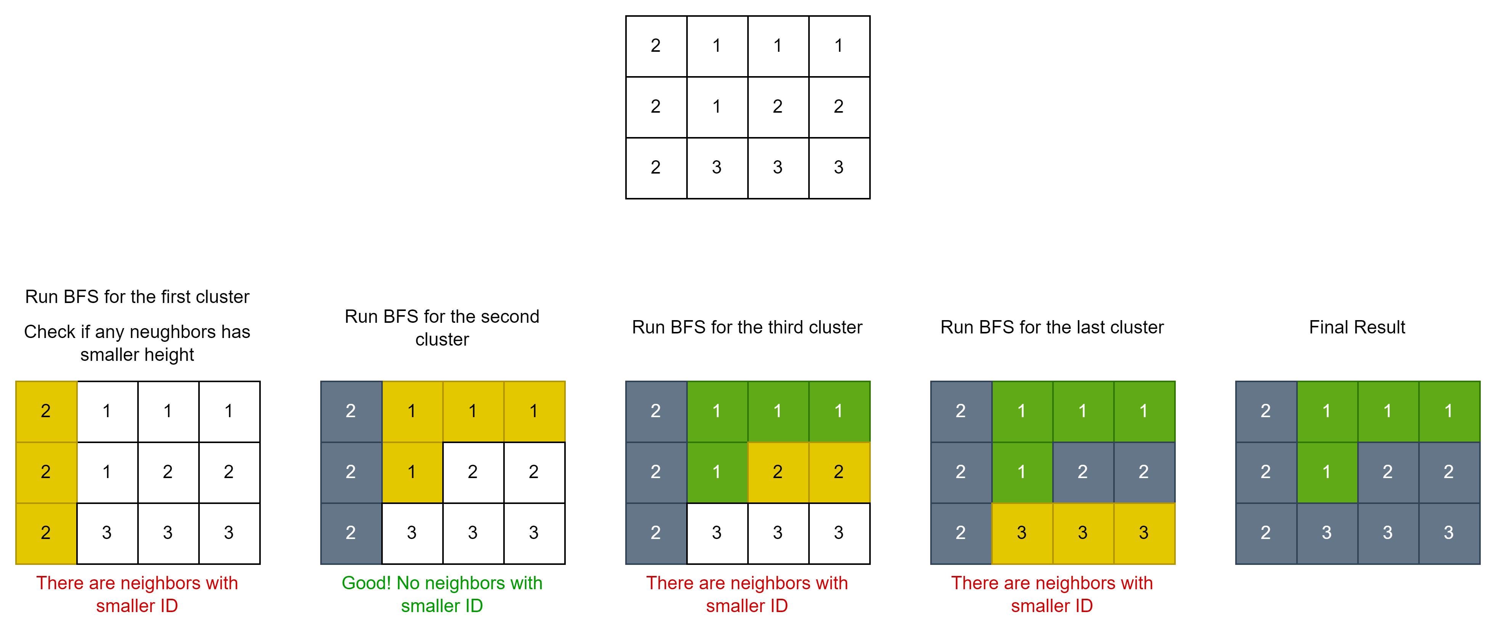
Terraces – BFS Approach

Slide 16
Implement Solution
Source: Kattis
Task: Terraces
Task ID: terraces

